Slide 1
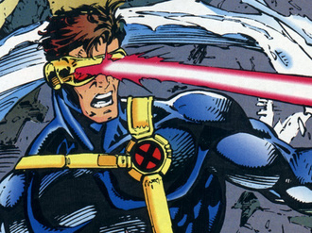
Laser Cat
Presented by:
Almeda Glenn Brandon Tan Troy Toh Lim Wei Heng

Slide 2
Disclaimer
Please note that the pictures provided in this presentation do not intend to infringe any copyright. Credits are given to the sources.

Slide 3
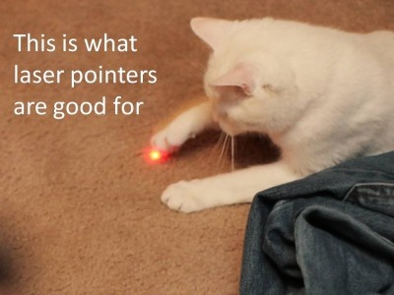

Slide 4
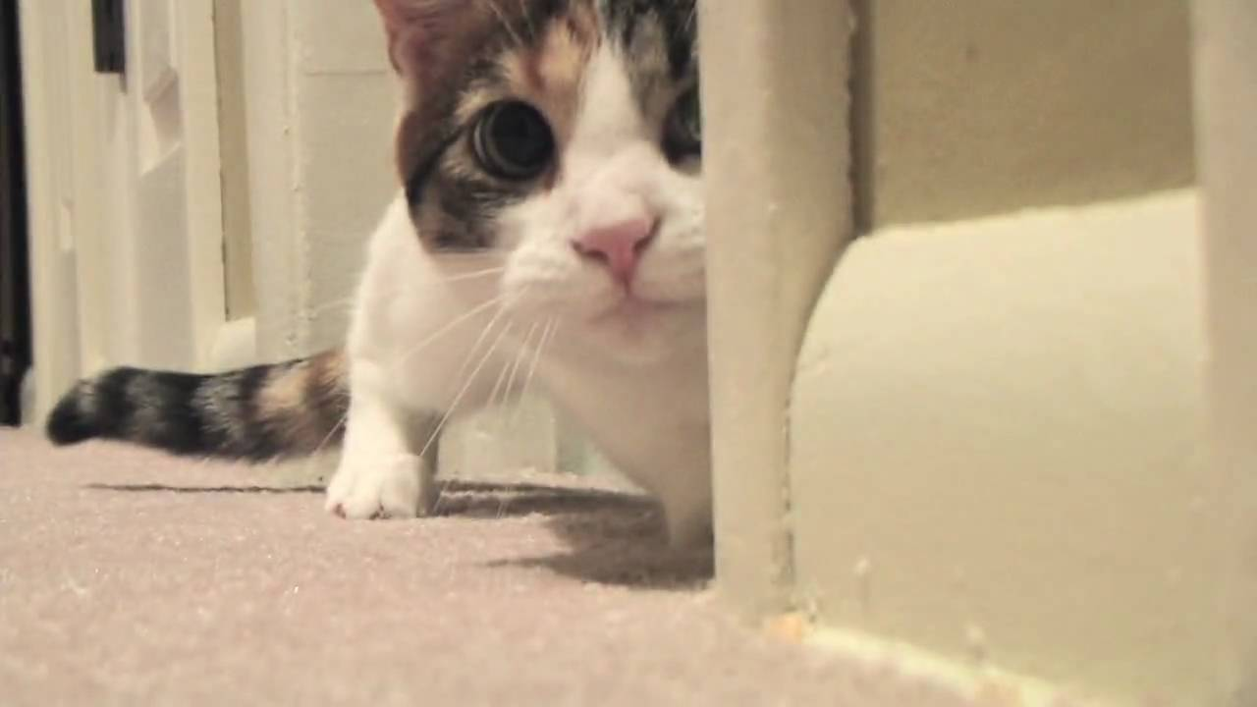
Overview
Our Tasks
Project Schedule
Gameplay Samples
Screenshots (Before & After)
Risks/Concerns
Random Inspirations

Slide 5

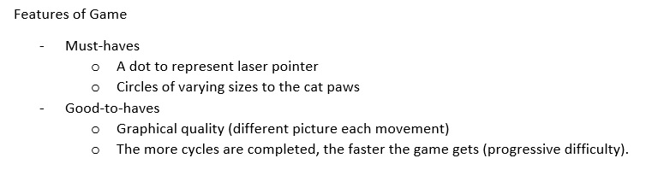
Our Tasks
Problem encounter and how we solved
How we improve our project better?
SML and who did what.

Slide 6
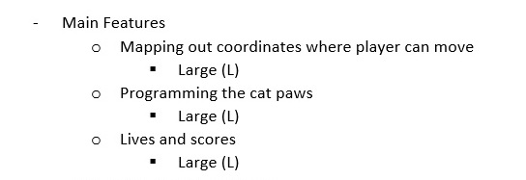
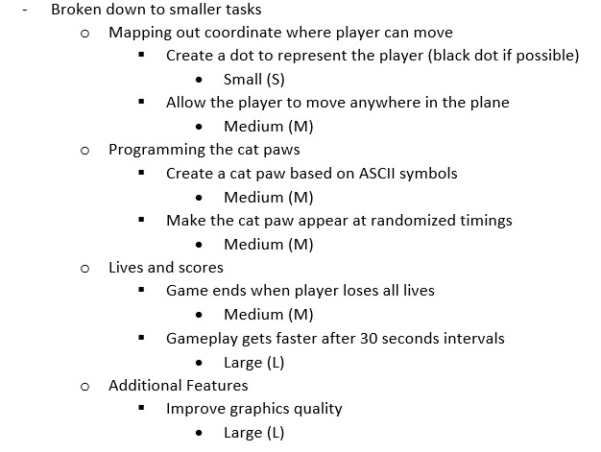
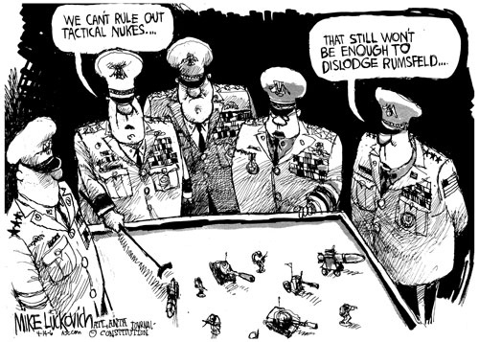
Our Tasks

Slide 7
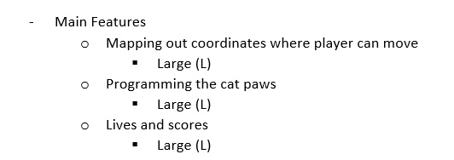
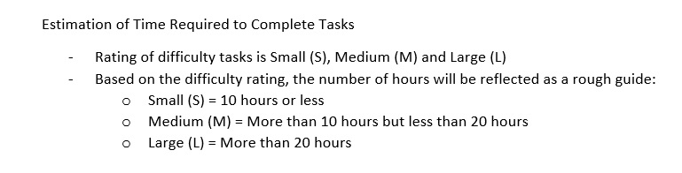
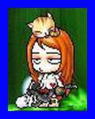
Our Tasks

Slide 8

60 hours!!!

Slide 9
Who did what?
Glenn – Game Design Lead/Documenter
Troy – Game Design/Programmer Assist/Documenter
Brandon – Game Programmer Assist
Wei Heng – Game Programmer Lead

Slide 10
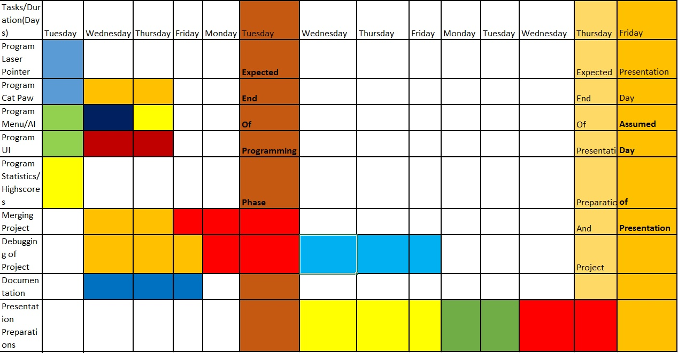
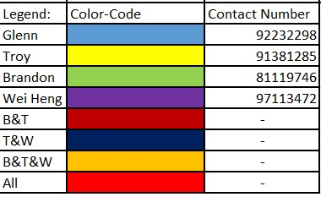
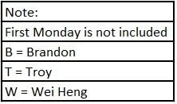
Original Project Schedule

Slide 11
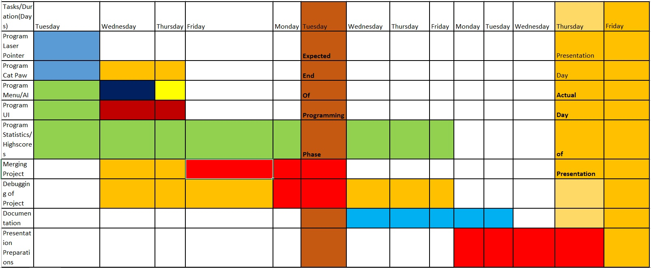
Actual Project Schedule

Slide 12
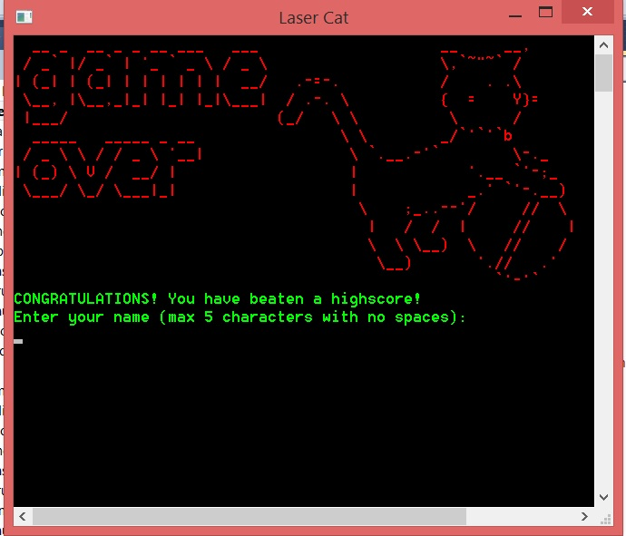
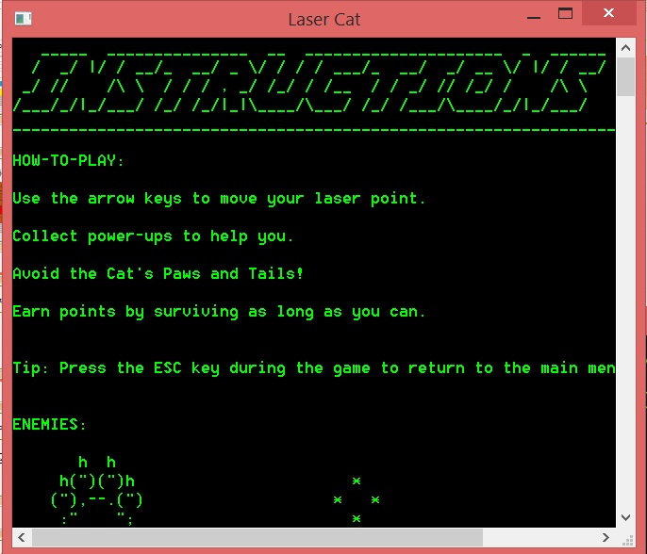
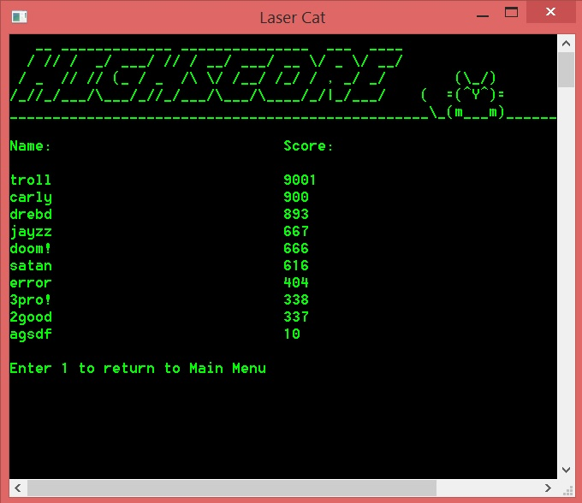
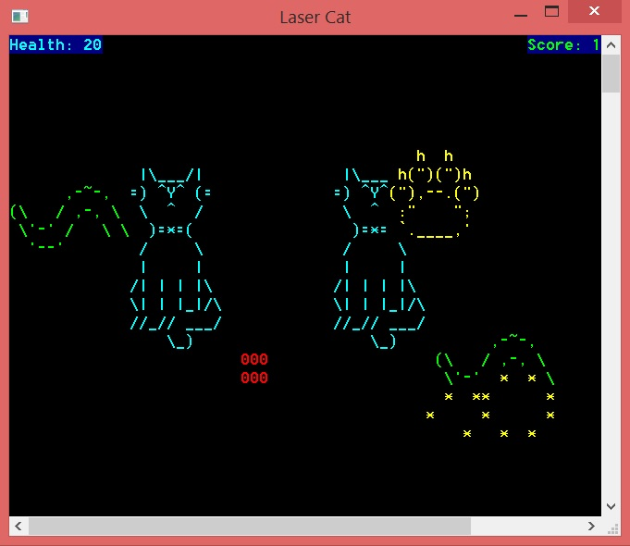
Gameplay Samples

Slide 13
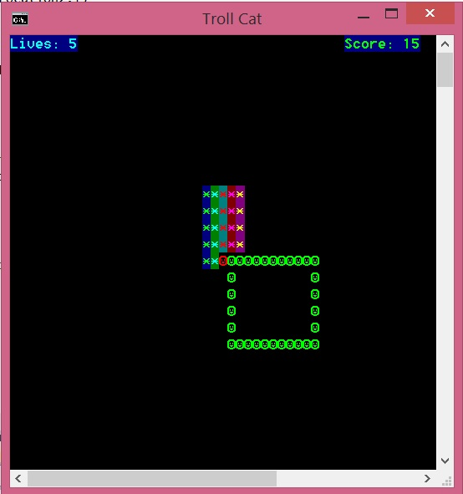
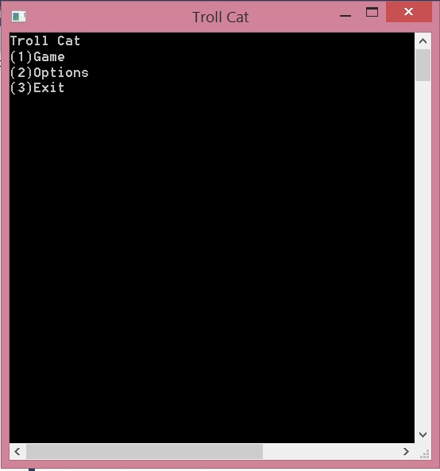
Screenshots (Before)
Initial Menu →
← Initial Gameplay

Slide 14
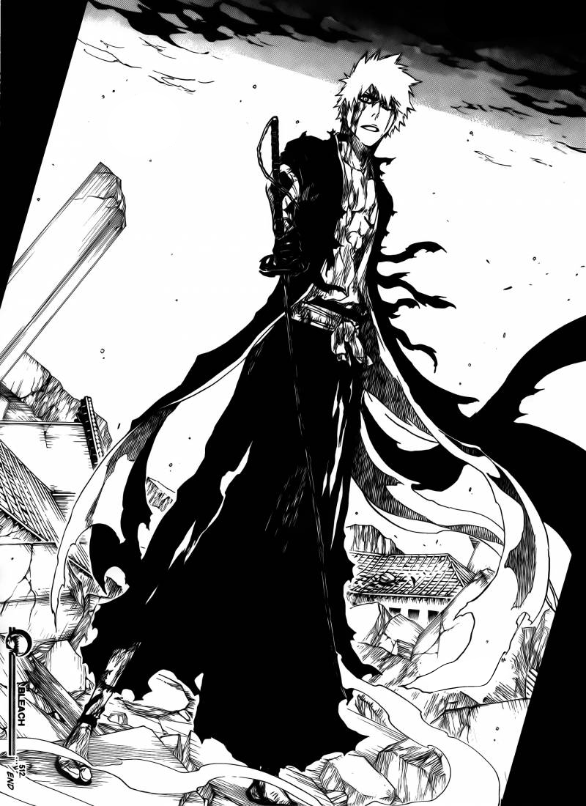
After much work…

Slide 15
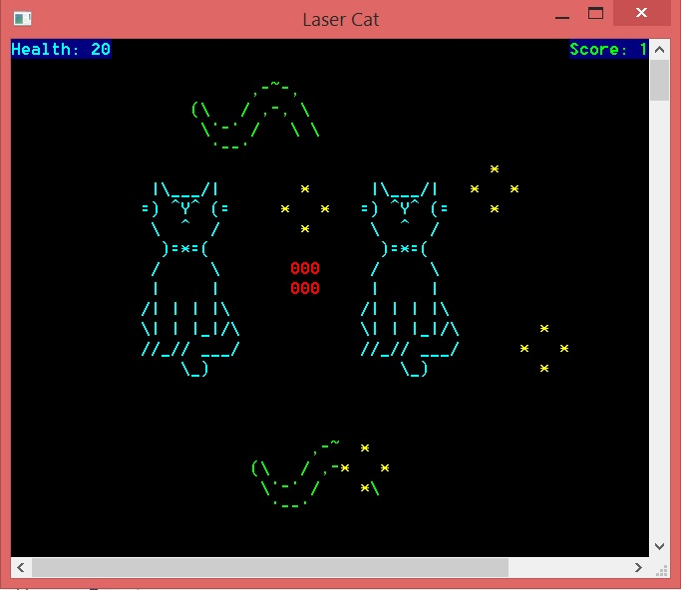
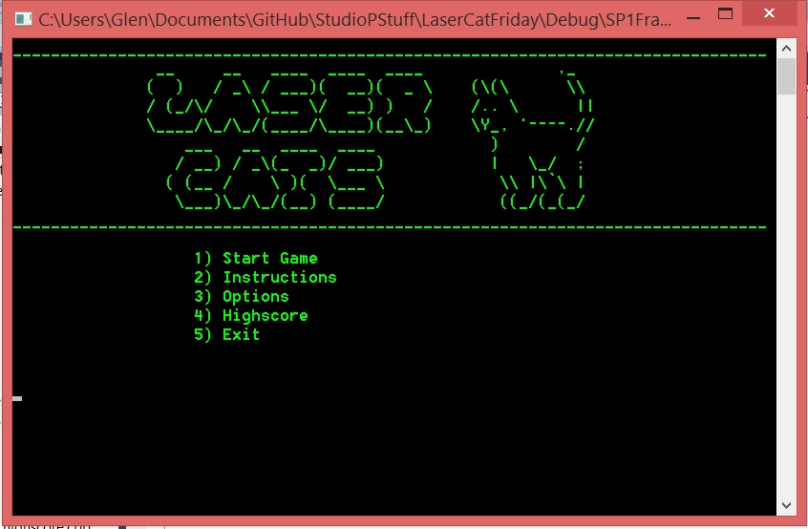
Screenshots (After)
Final Menu →
← Final Gameplay

Slide 16

Risks/Problems/Concerns
Perceived lack of reflexes
Unseen bugs in the gameplay

Slide 17
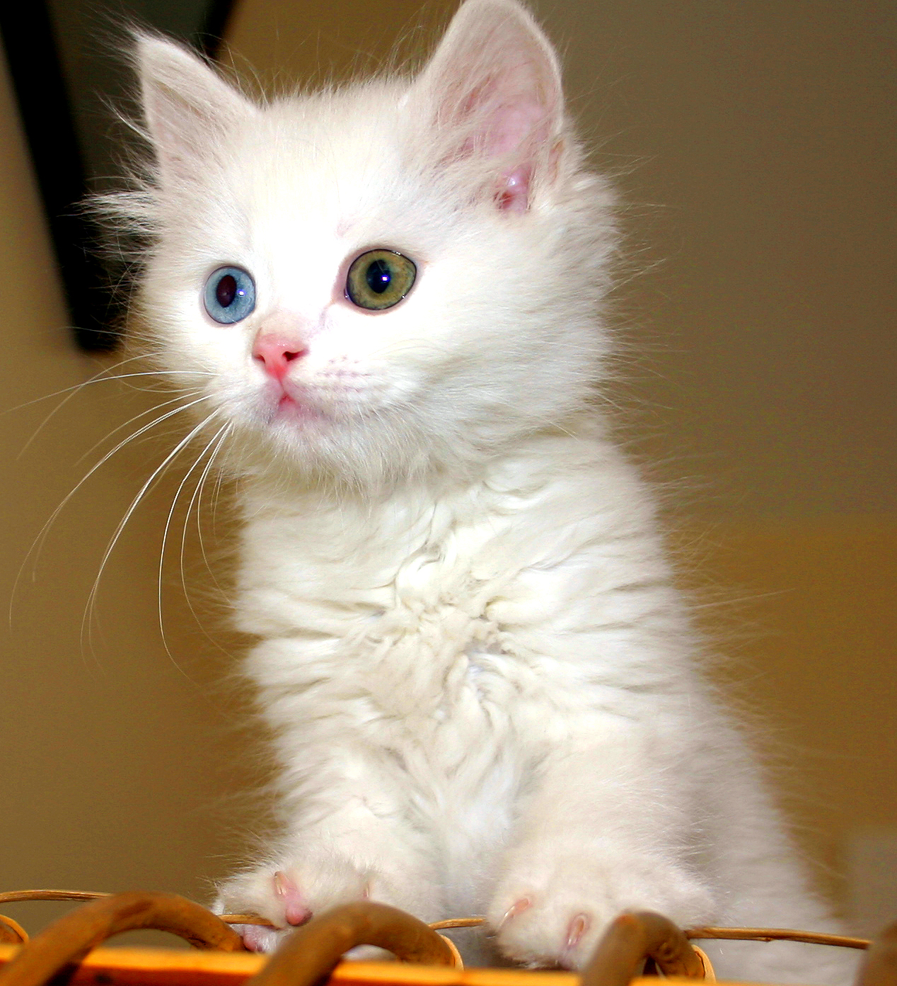
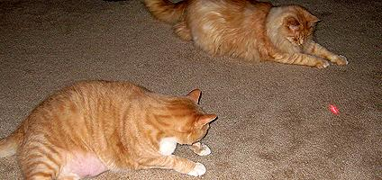
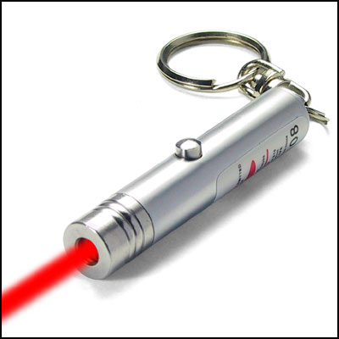
Inspirations

Slide 18
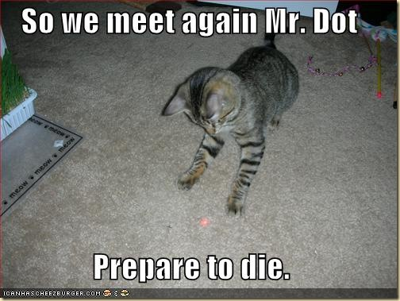

Slide 19
Thank You!!

